Slide 1


Slide 2
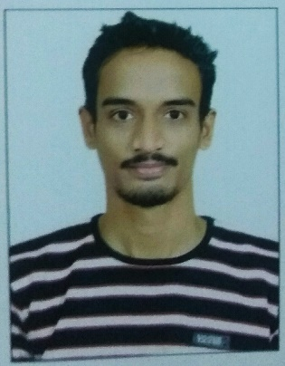
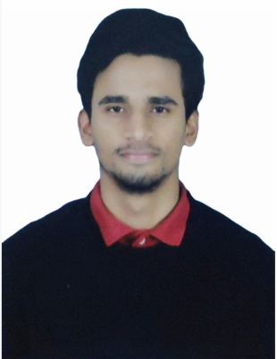
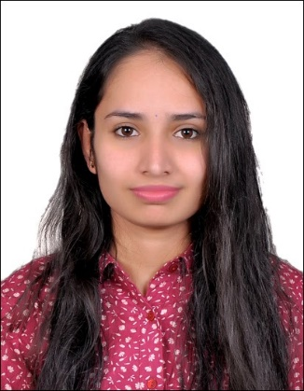
Project Highlights
Project Name : ATM Machine
Team Size : 03
Team Members Details (Professional Stamp Size Photo with few lines of individual briefing)
Intern Name – Divyesh Anant Marne
PS# 99002456
GENESIS Track Code – 2009BLRICP01
B.Tech -EXTC
Professional Skills- Critical thinking and problem solving.
Intern Name – Harshith H K
PS# 99002442
GENESIS Track Code – 2009BLRICP01
B.Tech -CSE
Professional Skills – Time Management, Active Listening , Interpersonal Skills, Management Skills and Problem Solving
Intern Name – Bindu K R
PS# 99002454
GENESIS Track Code – 2009BLRICP01
Education Details – B.E, EE
Professional Skills – Teamwork, Time Management

Slide 3

Project Video Snippet

Slide 4
Future development that can be implemented further
Enhancement of UI part.
Increase the security for transaction.
Add the features like apply for loan, credit and debit card.
Add the feature of changing phone number and password whenever required.
We can make it as android application for the same project
Add the voice recognition feature to the system

Slide 5

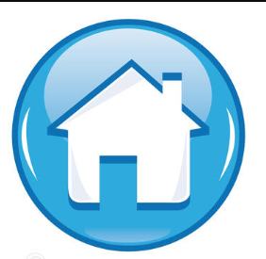
Thank You !

